Slide 1

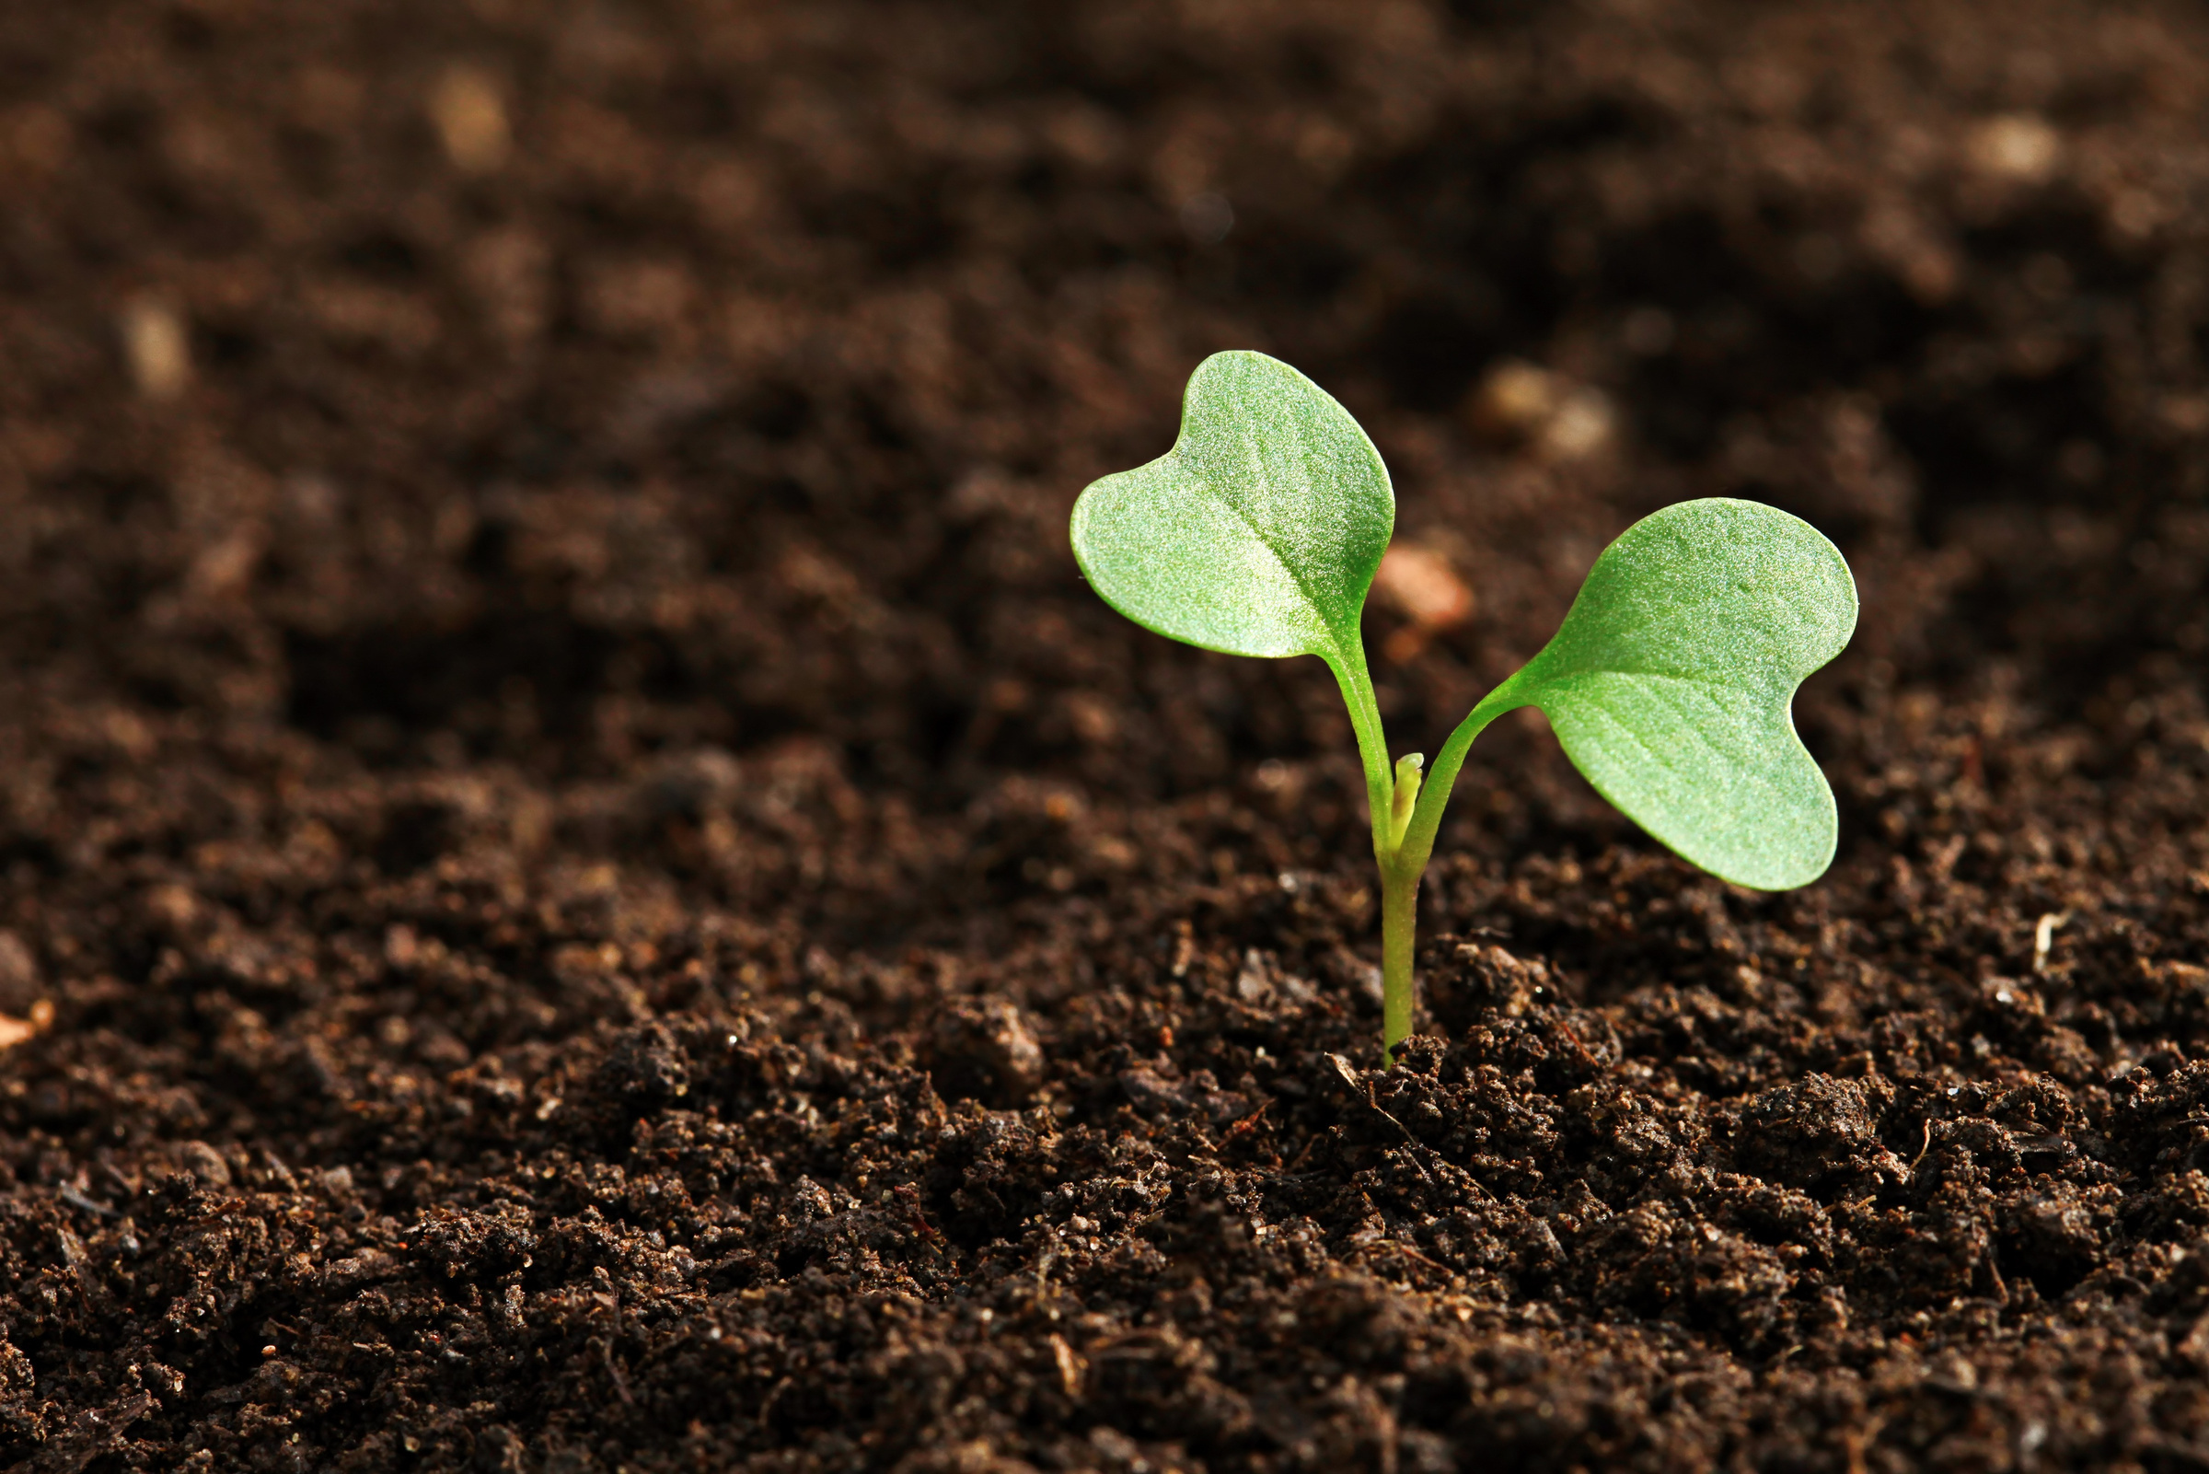

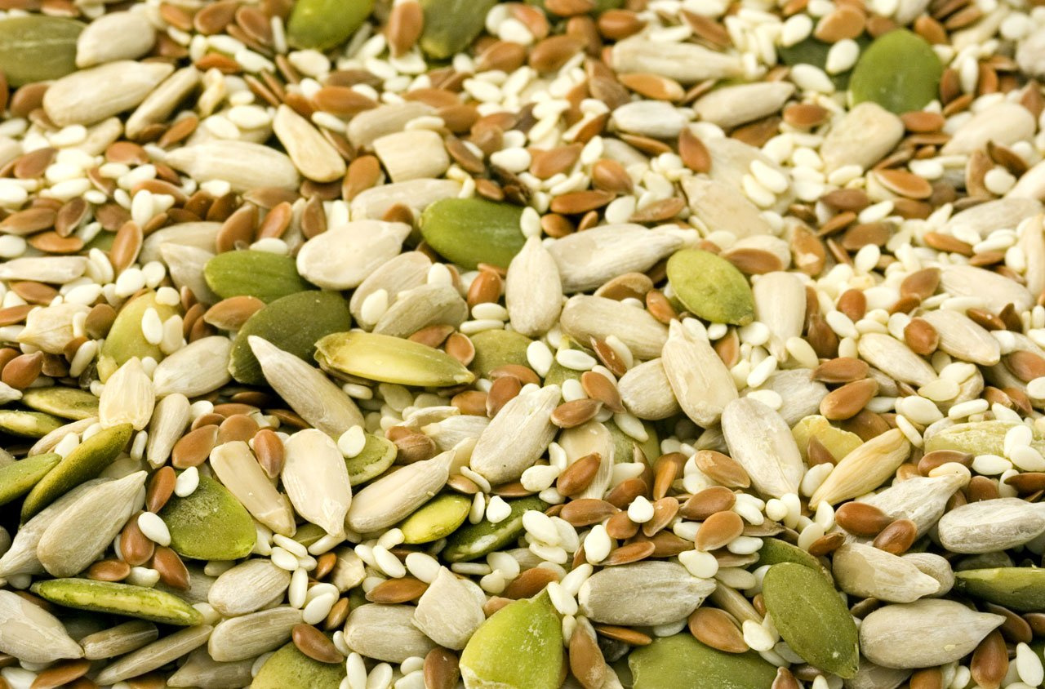
PrimSeedPower
CA24156
The awakened seed
STEM protocol on seed priming
Fascination of Plants day | FoPD 2026

Slide 2
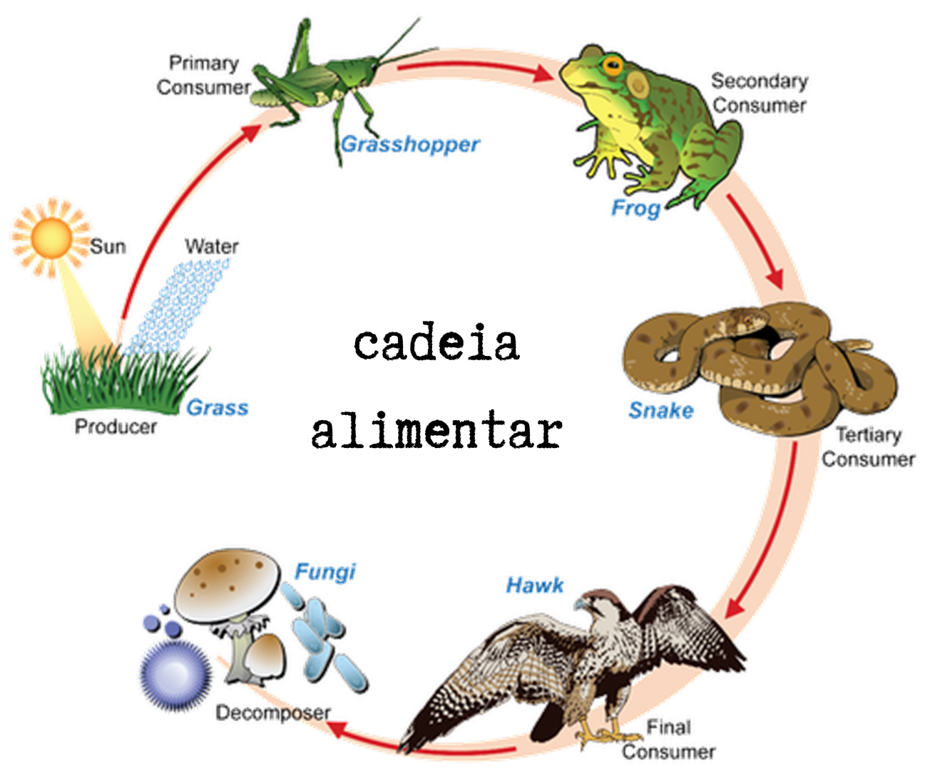
Are plants important?
Raw material
Food
Food chain
Oxygen
Ornament

Slide 3
From the seed to a new plant
Imbibition
The lag phase
Radicle protrusion
Fast water absorption driven by water potential ( ΨH₂O ≈ −100 MPa)
The seed swells and the seed coat softens
Mitochondrial and DNA repair
Protein synthesis
Osmotic adjustment
Reversible process: the seed can be dried back to its original moisture content without dying.
Second rapid uptake of water
Cellular expansion — germination complete
The seed loses desiccation tolerance as if it dries out
Phase I
Phase II
Phase III

Slide 4
Seed priming
Seed priming is controlled hydration that activates pre-germinative metabolism but stops before radicle protrusion
Faster germination
Uniform emergence
Metabolic memory
Stress tolerance
Primed seeds have already completed part of the early preparation for germination
Seedlings often emerge faster and more synchronously under suitable conditions
Repair of membranes, mitochondria and DNA
Enzyme synthesis and antioxidant accumulation
Improved stress tolerance can occur, depending on species and treatment

Slide 5
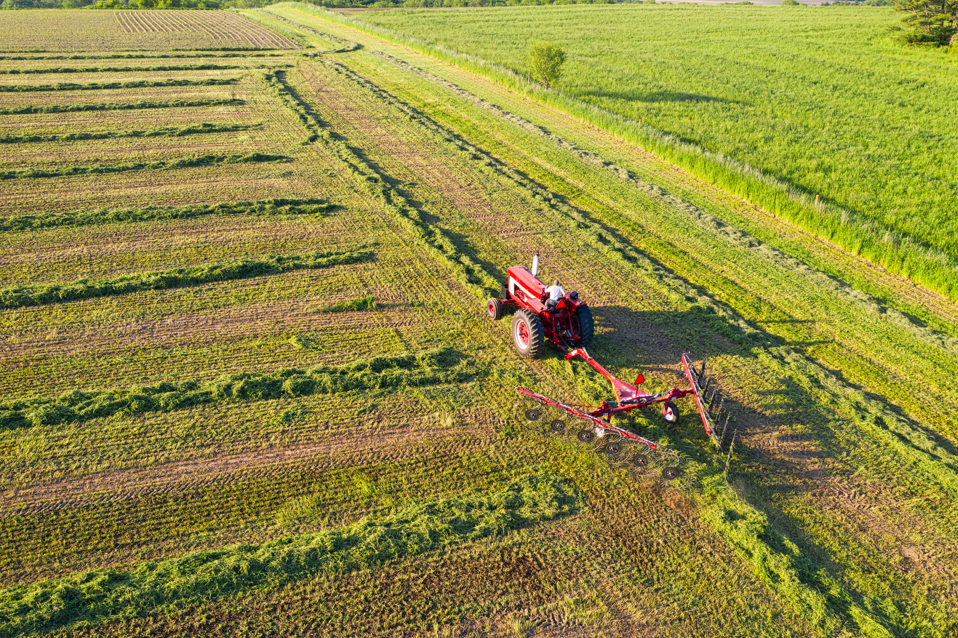
PROBLEM
It is the year 2050.
Fields that once fed millions are now hostile environments where most crops can no longer survive. The global population has reached nearly 10 billion.
Food security is no longer just a challenge; it is a race against time.
MISSION
To test whether priming helps seeds germinate better under salty conditions.

Slide 6

PRIMING agents
Water
Mechanism: Fast hydration
Simplest priming technique
Dry seeds = control
Stop before radicle protrusion
It softens the seed coat
10 g L-1
Mechanism: stress preparation
Lower external water potential
Slows water uptake
Sugar/osmotic cue; prepare fresh
3 g L-1
Mechanism: stress preparation
May prepare salt-stress responses
Stress-response pathways may activate
May improve salt-stress response
Too much salt is toxic
2%-4% chamomile tea
Mechanism: plant-extract priming
Antioxidant source
Acids can help soften tough seed coats
High concentration may inhibit growth
Contains plant bioactive compounds

Slide 7
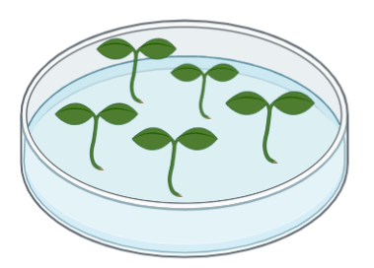
Experimental design
Hydropriming
Halopriming
Sugar / osmotic priming
Plant-extract priming
Dry control seeds + primed seeds; same number per plate
Temperature: 20–25 °C
1 plate = 1 replicate
3 replicates per treatment
Saline stress: pilot 75-100 mM NaCl; 150 mM = severe stress
Germination percentage (GP)
Mean germination time (MGT)
Seedling vigor index (SVI)

Slide 8
PrimSeedPower
CA24156
Let's practice!
STEM protocol on seed priming
Fascination of Plants day | FoPD 2026

Slide 9
Teacher note: correct terminology
Dry seeds are the control; hydropriming is a treatment.
Chamomile tea is plant-extract priming, not biopriming.
Priming must stop before radicle protrusion.
Mild salt priming may prepare stress-response pathways, but high salt is harmful.
Run a small pilot first: seed species, priming time and salt level strongly affect results.

